Slide 1

The absolute basics in doing stats in R
No (well, some) theory, no data wrangling, just “here’s how to do a t test”

Slide 2

Dr Andrew Mackenzie
Senior Lecturer
Applied Visual Cognition & Neuroscience
Sports/Transport/Medicine

Slide 3

Dr Sarah Gardner
Principle Lecturer
Social Psychology
Bullying
Statistical Modelling
SEM

Slide 4

Dr Jens Roeser
Senior Lecturer
Psycholinguistics
Bayesian approaches

Slide 5

We are NTU Psychology

Slide 6
Plan
Part 1
Navigating R
Using commands
Reading in Data
Basic statistical-tests
Part 2
4) Regressions and using lm for EVERYTHING (and why the previous section was a waste of time).
Part 3
5) using mixed effects models (a simple extension of lm and why you no longer need to do anything else). But only if there’s time and a desire…

Slide 7

Step 1

Slide 8
What are the concerns (if any)?

Slide 9

Some points to keep in mind…
Please pay attention
No need to be on emails
No one is going to die if you don’t respond to them
We can all go at the same pace.
If you have a question, ask it to everyone
Share your misery.
If you get an error message, this will be used as a class exercise! So please share!
We may not know the answer. This is fine. Let’s find out the answer as a group
Don’t think R as a language. That’s off-putting
USE R OUTSIDE THIS WORKSHOP!!
Take the time to practice on your data or mock data

Slide 10

Part 1: the basics of R and doing basic stats

Slide 11
Let’s get the material
https://github.com/jensroes/edge-hill-r-workshop/

Slide 12
Getting started with R studio

Slide 13
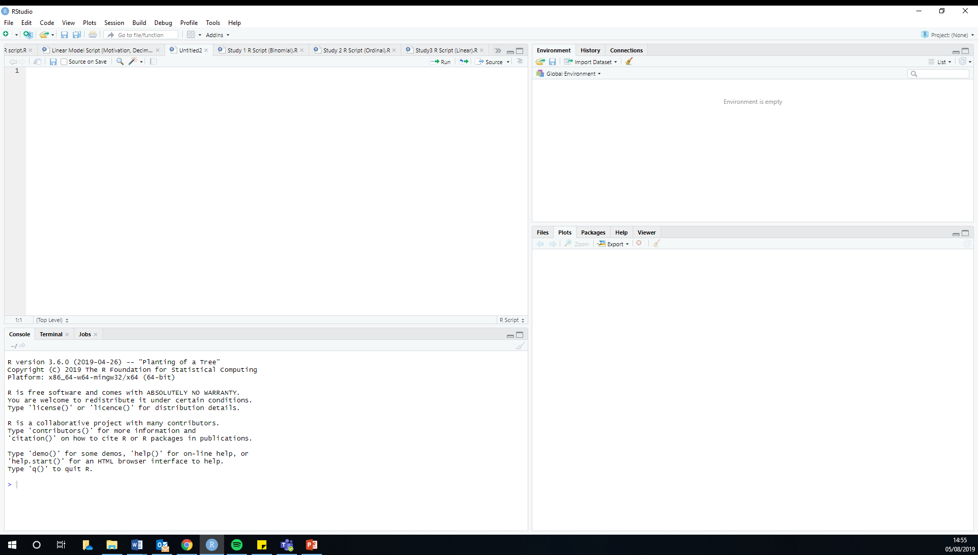
This is where your items appear e.g. your models, datasets etc
This is where you write your scripts
This is where you can check things... Plots and packages would be the main two things
Your outputs will appear here
This is where you can also write code that doesn’t go into your script. e.g. to test something

Slide 14
Using the command – EXERCISE
1. Type: 2 + 400 in the script panel (top left)
2. Then click Run (or CTRL Enter)
3. (The answer appears below in the console)
4. Put a # before the command
5. Now try to run the command
Highlights
Either click “Run” on the line you are on or CTRL Enter to run that command
If you highlight more than one line you can run all the commands at once
Anything after a “#” is now a comment and is not processed as a command
Notes:
Do some multiplication

Slide 15
Some quick coding principles
Functions
These are inbuilt commands that contain instructions to perform a specific task
“t.test”, “sum”, “plot”
Arguments
These provide more information about a function
Object
These are elements we create and name
We can assign a calculation/operation that has used a function and argument to a object (sometimes referred to as a variable)

Slide 16
Putting this all together…
TheAnswerToEverything <- sum (40, 2)
Object
Function
Arguments
“assign to”

Slide 17
Mathematical Operators
Basic mathematical operators
Miscellaneous
+
-
*
/
>
<
~ “as a function of”
| (pipe)

Slide 18
Magic ‘c’
Concatenate (combine)
Combines objects, numbers, vectors etc into one
c(2,4,8)

Slide 19
1. Before anything else:
Use Projects!

Slide 20
1. Projects
Projects are a lifesaver. They stop the faff related to needing to set up directories, they keep everything tidy in one folder, and they make findings and re-running scripts much easier
Create a suitable directory on your computer (a folder within a specific research project)
File -> New Project -> Existing Directory -> Select the Folder

Slide 21
2. Packages

Slide 22
2. Packages
Base R comes with many functions e.g. “t.test”
But you will likely need to use other functions
These come in different “packages”
Highlights
R studio is like a phone: it comes with some functionality, but you will likely install other apps to make the most out of your phone. This is the equivalent to what “packages” are

Slide 23
2. Installing Packages – EXERCISE
Type:
install.packages(“readxl”)
library(readxl)

Slide 24
3. Reading in Data
Read in your data and assign it to something meaningful
Click on “Import Dataset” (top right, in the environment tab)
Read from excel (data does not need to be in .csv format)
Identify the data “Sports Cognition”
Change the name of the dataset below
I also use the prefix “df_” for datasets (dataframes)
(Copy the code if you want to put it into your script [recommended])
Click Import

Slide 25
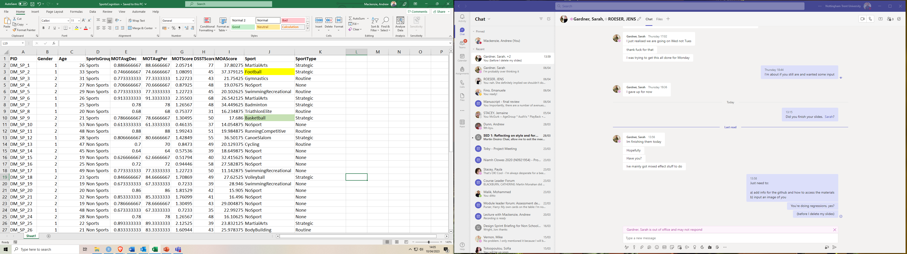
Mackenzie et al (2022)
Exploring cognitive ability across sports groups

Slide 26

Multiple Object Tracking (MOT)

Slide 27
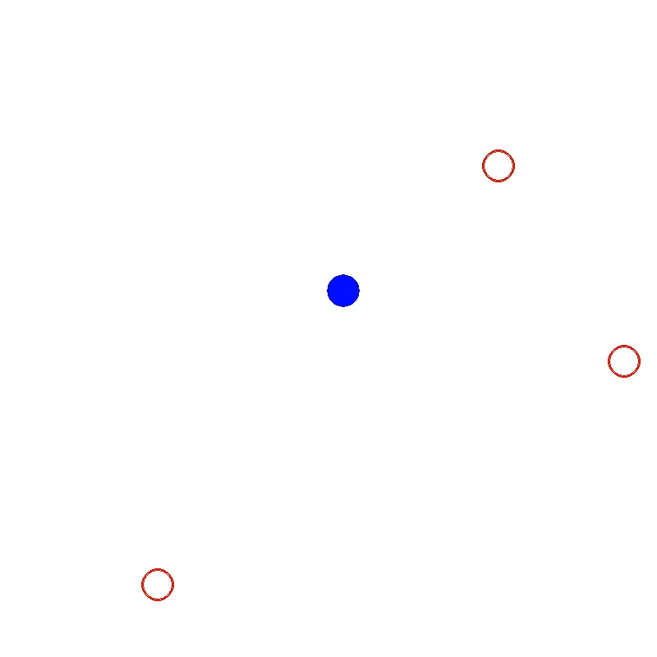
Multiple Object Avoidance (MOA)

Slide 28
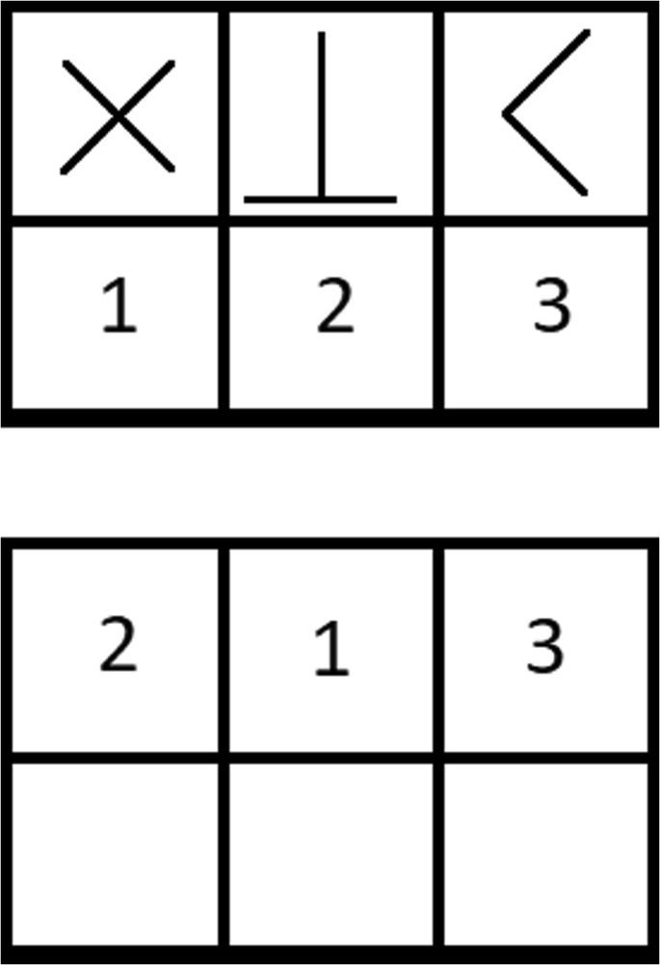
Cognitive Processing Speed

Slide 29
4. What should my data look like
Dependent on the function

Slide 30
General Types of layouts
“Wide” Format
PID | Trial | Score
AM01 | A | 1140
AM01 | B | 1423
AM01 | C | 1277
AM01 | D | 1954
AM01 | E | 1793
AM01 | F | 1979
AM01 | G | 1286
AM01 | H | 1220
AM01 | I | 1293
AM01 | J | 1268
RD02 | A | 1714
RD02 | B | 1956
RD02 | C | 1416
RD02 | D | 1525
RD02 | E | 1628
RD02 | F | 1723
RD02 | G | 1952
RD02 | H | 1079
RD02 | I | 1372
RD02 | J | 1090
“Long Format”
E.g. one row per participant
E.g. one row were trial/observation
PID | TrialAScore | TrialBScore | TrialCScore | TrialDScore | TrialEScore | TrialFScore | TrialGScore | TrialHScore | TrialIScore | TrialJScore
AM01 | 1356 | 1695 | 1686 | 1330 | 1711 | 1111 | 1392 | 1115 | 1666 | 1654
RD02 | 1613 | 1665 | 1370 | 1171 | 1931 | 1989 | 1966 | 1916 | 1288 | 1727

Slide 31
5. Do I need to use R to sort/wrangle/clean my data?

Slide 32
No….but

Slide 33
And that’s all you need to know to get started!
Let’s do some statistical tests :D

Slide 34
Some data checking and some basic descriptives
…But much better ways of doing this. This is just rough stuff for now

Slide 35
Always check your data
Make sure your variables are in the appropriate typing
If they are categories (e.g. Group 1; Group 2), you want to check they are “factors”
If they are numbers, you want to make sure they are numeric
Lots of ways to do this. One easy way is to use “str”:
str(df_Sports)
To change variables to the appropriate typing (e.g. a factor) we can use “as.factor”
df_Sports$SportsGroup <- as.factor(df_Sports$SportsGroup)

Slide 36
Some basic descriptive and plot functions
mean
sd
max
min
boxplot
hist
Note, all these base R functions use the “$” syntax:
df$VariableName
E.g. mean(df$Score)

Slide 37
Simple Correlations

Slide 38
Correlations
Run the test
m1.corr <- cor.test(df_Sports$DSST, df_Sports$LogitMOT, method = "pearson")
4. View the results
m1.corr
What you are calling the model
The function
Variable 1
Data frame $ variable name
Variable 2
Data frame $ variable name
Method
Pearson, spearman etc

Slide 39
Correlations
Now also try with the variables:
1) MOTScore
2) MOAScore

Slide 40
You just did your first statistical test in R!
(hooray)

Slide 41
Independent t-test
Beginning to move towards more common syntactical structure for tests
Notes:
Remove long variable names

Slide 42
Independent measures t-test
Run the test
m1.independent <- t.test(MOAScore ~ SportsGroup, paired = FALSE, data = df_Sports)
Notes:
1. The syntax changes slightly
Uses a “ ~ “
Tell the function which data to use at the end, not for each variable
What you are calling the model
The function
Variable 1
The dependant variable
Variable 2
The independent variable
(the grouping variable)
Repeated or not
TRUE or FALSE
(FALSE is default)
The data set these variables belong to

Slide 43
Steps for a Independent measures t-test
Viewing the results
Method 1 - appears in top left window (clickable)
Click on the model on the Environment window
Method 2 – appears in top left window (clickable)
View (m1.independent)
Method 3 – appears in console below
m1.independent (just type name of model)

Slide 44
Runing a Levene’s test (from the package “car”)
leveneTest(MOAScore ~ SportsGroup, data = df_Sports)
If equal variances assumed, add to previous ttest model function:
, var.equal = TRUE

Slide 45
You just did your second statistical test in R!
(hooray)

Slide 46
T-test Error Check Exercise
Open the Script “Error Check Exercise 1”

Slide 47
One-way ANOVAs
The between subjects kind

Slide 48
One-way ANOVA (between)
Maybe Sports vs Non-Sports is too broad. Maybe we need to break down the sports category
Non-Sports
Strategic
Routine
You might want to do some descriptives? You could use the code:
tapply(df_Sports$MOAScore, df_Sports$SportType, mean)
boxplot(df_Sports$DSSTScore ~ df_Sports$SportType)
(I’m not going to focus too much on this as Jens will show you much nicer ways of doing descriptives using “Tidyverse”)

Slide 49
Steps for a One-way ANOVA (between)
Run the test
m1.anova <- aov(MOAScore ~ SportType, data = df_Sports)
2. View the results
summary (m1.anovabetween)
Notes
1. Use “summary (model)”
What you ae calling the model
The function
Dependant Variable
Independent variable
(grouping variable)
Data frame

Slide 50
Steps for a One-way ANOVA (between)
4. Posthoc comparisons
TukeyHSD(m1.anovabetween)
5. Alternatively using “emmeans” library(emmeans)
emmeans(m1.anovabetween,
specs = pairwise ~ Group,
adjust = "bonferroni")

Slide 51
You just completed a complete research methods 1 course (kind of)!
(hooray)

Slide 52

Congratulations!
You’ve learned how to do stats in R

Slide 53
Syntax Summary
Read in your data read_excel(“filename.xlsx”) [if using a csv file you would use read_csv(“filename.csv”)]
View data View(df)
Check structure of data str(df)
Descriptives
Means mean(df$variable)
SD sd(df$variable)
Means (per group) tapply(df$dependantvariabe, df$groupingvariable, mean)
SD (per group) tappy(tapply(df$dependantvariabe, df$groupingvariable, sd)
Repeated ttest: t.test(df$variable1, df$variable2, paired = TRUE)
Between ttest: t.test(dependantvariable ~ independentvariable, paired = FALSE, data = df) (#NOTE: add var.equal = TRUE if equal variances assumed)
Levene test (“car” package) leveneTest(dependantvariable ~ groupingvariable, data = df)
Correlation: cor.test(df$variable1, df$variable2, method = “pearson”)
Regression lm(outcome ~ predictor 1 + predictor 2, data = df)
One way between aov(dependantvariable ~ independentvariable, data = df)
Posthoc (using emmeans) emmeans(modelname, specs = pairwise ~ Group, adjust = "bonferroni")
One way repeated (need long data format) aov(dependantvariable ~ independentvariable + Error(subject/independentvariable), data = df)

